Slide 1
Grade 3: Alignment to Mathematics Grade-Level Standards
Notes:
This module was last updated on January 2017.
Over the past several years, we have seen several changes in states K-12 assessment systems as states work (sometimes collaboratively) to design assessment systems that provide information on students’ progress toward college and career readiness in mathematics and English language arts. For many states, this was a major change from previous assessments, which were largely characterized by multiple-choice items that were not reflective of the comprehensive set of skills defined by college and career ready standards.
The goal of this module is to provide guidance on grade 3 item development and alignment, highlighting the Council of Chief State School Officers Criteria for High-Quality Assessments and the collective experiences of the assessment consortia and individual states throughout their multi-year assessment design processes.

Slide 2
Session Objective
The purpose of these materials is to help develop understanding of the expectations of high-quality summative assessment items. The concepts shown throughout these modules can be useful for classroom questioning and assessment, but the items themselves may need to be slightly modified.

Slide 3
CCSSO Section C: Align to Standards – Mathematics
Criterion C.1: Focusing strongly on the content most
needed for success in later
mathematics
Criterion C.2: Assessing a balance of concepts, procedures, and applications
Criterion C.3: Connecting practice to content
Criterion C.4: Requiring a range of cognitive demand
Criterion C.5: Ensuring high-quality items and a
variety of item types
Notes:
Based on the need to provide guidance for what high-quality assessments looked like, the Council of Chief State School Officers created the Criteria for Procuring and Evaluating High-Quality Assessments. More information on this document can be found in the “Test Level Considerations” presentation for Mathematics. The full document is also available online. http://ccsso.org/News_and_Events/Press_Releases/State_Chiefs_Release_Criteria_for_High-Quality_Assessment.html
In 2013, CCSSO worked with their stakeholders, the Chief State School Officers, to draft principles of high-quality assessments. These principles described the characteristics of high-quality assessments aligned to college and career readiness. Through the end of 2013 and into 2014, CCSSO continued working with their stakeholders to clarify what these principles mean. The principles became criteria with metrics used to judge whether these principles were realized in assessment systems. These are the criteria on which this review of assessment systems will be based.
There are six sections of the CCSSO Criteria. Overarching goals and technical quality (e.g., accessibility, validity, and reliability) come first. Then two sections on content alignment. Then reports, administration, and a section where states can add criteria reflecting individual state needs. The overall document is designed to be “drop in” for a state’s RFP and can be modified as needed. It could also could serve as a “drop in” checklist of criteria for evaluating an existing assessment. For the purpose of this module, we will focus on Section C: Align to Standards – Mathematics. The slide shows the five content alignment criteria in Section C of the CCSSO document, which is the section covering mathematics.
College and career readiness has specific implications for math content, math instruction, and therefore, math assessment. We are not talking about just *any* mathematics, by the way, but mathematics that aims at college and career readiness. States require assessments that match the depth, breadth, and rigor of the standards, accurately measure student progress towards college and career readiness, and provide valid data to inform teaching and learning.

Slide 4
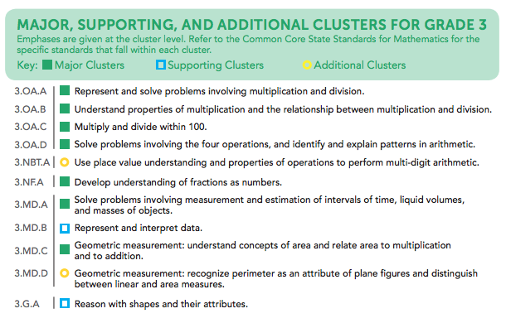
Notes:
Criterion 1 emphasizes the content most needed for success in later mathematics. Throughout this presentation, this will be referred to as “major work of the grade” or just “major work.” This table shows the grade 3 content clusters classified as Major, Supporting, and Additional.
Major Clusters coherently capture the emphases at each grade; Supporting Clusters have natural connections to Major Clusters; and Additional Clusters stand well on their own, with weaker natural connections to the Major Clusters. PARCC, Smarter Balanced, and several states working independently on developing aligned assessments used these designations to inform the proportional representation of content reflected in their summative test blueprints.
It is also worth pointing out that the structure of the standards organized by domain, then by cluster, reveal things that are different in these standards than states’ previous standards. For example, there has never been a standards document before that uses Ratios and Proportional Relationships as a top-level organizer; the fact that CCSS uses it as a top-level organizer signals its emphasis in the document. In general, standards that are college and career ready based on evidence will drive towards a substantial amount of algebra for all students during middle school. The major work designations trace that trajectory.

Slide 5
Ten Principles of CCSS-Aligned Items
1. Most items aligned to standards in supporting clusters connect to the major work of the grade.
2. Items are designed to address the aspect(s) of rigor (conceptual understanding, procedural skill, and application) evident in the language of the content standards.
3. Items are designed to attend to content limits articulated in the standards.
4. Most items aligned to a single content standard should assess the central concern of the standard.
5. Representations are well suited to the mathematics that students are learning and serve an important purpose within the item itself.
6. Items use mathematically precise language, are free from mathematical errors or ambiguities, and are aligned to the mathematically appropriate standard.
7. The demands of items measuring the Standards for Mathematical Practice are appropriate to the targeted grade level.
8. Item types are chosen to match the item’s purpose and as part of the evidence required by the standards.
9. Most items measuring the Standards for Mathematical Practice are also aligned to content standards representing the major work of the grade.
10. Items written at the cluster or domain level measure key integration points not necessarily articulated in individual standards but plausibly implied directly by what is written.
Notes:
Here are ten principles that can be used to guide the creation of CCSS-aligned assessment items. This list was generated based on common issues identified by the assessment consortia as well as individual states as they worked to develop next-generation assessment systems. You will also note connections back to the CCSSO criteria. For example, alignment principles 1 and 9 are used to support Criterion 1, focusing strongly on the content needed for success in later mathematics. Note that these two also use the phrase “major work of the grade” as defined in the previous slide. As another example, Principle 2 is directly tied to Criterion 2, assessing a balance of concepts, procedures, and applications.
Each principle will be illustrated through examples selected from publicly available sources or created by Student Achievement Partners content staff.
Please note that in grade 3 all of the example items shown in this presentation are intended to be delivered without a calculator.

Slide 6

Alignment Principle #1
Most items aligned to standards in supporting
clusters connect to the major work of the grade.
Notes:
The word “supporting” that is used to describe a subset of the K-8 Common Core State Standards for Mathematics signals that these standards are well connected to the content representing the major work of the grade. Many of the standards in the Measurement & Data domain, for example, require students to solve problems based on the grade-level work in the Operations & Algebraic Thinking and the Number & Operations – Fractions domains. These connections reinforce the important work in grades K-8, allowing students to engage deeply with the content instead of seeing mathematics as a set of discrete topics.

Slide 7
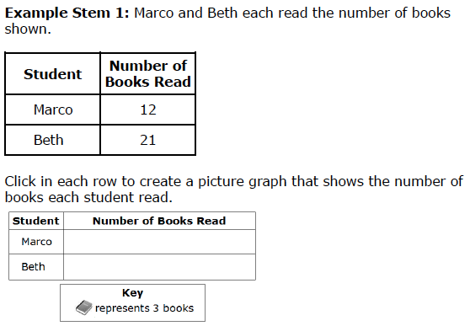
Most items aligned to standards in supporting clusters connect to the major work of the grade.
3.MD.B.3. Draw a scaled picture graph and a scaled bar graph to represent a data set with several categories. Solve one- and two-step “how many more” and “how many less” problems using information presented in scaled bar graphs.
Notes:
© Item retrieved from the Smarter Balanced Grade 3 Claim 1 Item Specifications. Available from http://www.smarterbalanced.org/assessments/; accessed April 2016.
Let’s look at this example item written to illustrate Alignment Principle 1.
Answer key: Student creates 4 books next to Marco and 7 books next to Beth.
What makes this item a good illustration of Alignment Principle 1?
This supporting standard for grade 3 connects back to the major work of the grade in the OA domain. While the second sentence of the standard offers opportunities for item development that connect to the major work in the NBT domain, the more subtle connection to major work is shown in this example item which connects the creation of the scaled picture graph to students’ work with multiplication and division within 100 in the OA domain.

Slide 8

Alignment Principle #2
Items are designed to address the aspect(s) of rigor (conceptual understanding, procedural skill, and application) evident in the language of the content standards.
Notes:
The language used in the standards provides information about which components of rigor should be targeted in items written for those standards. Words and phrases like “extend previous understandings,” “fluently multiply,” and “solve” signal a need for items that measure conceptual understanding, procedural skill, and application, respectively. The following slides provide examples of grade 3 items, the standards to which they are written, and the key words signaling the components of rigor.

Slide 9
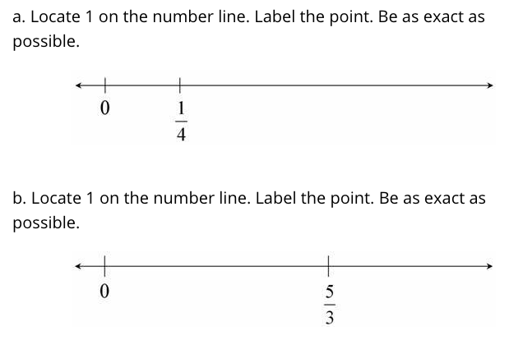
Items are designed to address the aspect(s) of rigor (conceptual understanding, procedural skill, and application) evident in the language of the content standards.
3.NF.A.2 Understand a fraction as a number on the number line; represent fractions on a number line diagram.
Notes:
© Item retrieved from Illustrative Mathematics. Available from https://www.illustrativemathematics.org/content-standards. Accessed April, 2016.
Let’s look at this example item written to illustrate Alignment Principle 2.
Answer key: Student places each point in correct location within an established tolerance interval; exact error tolerance often decided by state content experts with their vendors, often refined after data collection (field testing)
What makes this item a good illustration of Alignment Principle 2?
The verb “understand” used in the standards communicates that there is an expectation for conceptual understanding. The item shown here requires a deeper understanding of fractions than what was often required on past state assessments. Students need to know the meaning of ¼, not just how to find it on a number line that has been partitioned into fourths. Through the meaning of ¼, they are asked to locate 1. Similarly, part B asks students to work from a non-unit fraction, but still requires a strong understanding of the relationship between a unit fraction 1/b and a non-unit fraction a/b.

Slide 10

Items are designed to address the aspect(s) of rigor (conceptual understanding, procedural skill, and application) evident in the language of the content standards.
3.OA.A.4 Determine the unknown whole number in a multiplication or division equation relating three whole numbers.
Notes:
© Item retrieved from the PARCC Grade 3 EOY Test. Available from https://prc.parcconline.org/assessments/parcc-released-items; accessed April 2016.
Let’s look at this example item written to illustrate Alignment Principle 2.
Answer key: 40
What makes this item a good illustration of Alignment Principle 2?
Standard 3.OA.A.4 is intended to be primarily assessed through procedural problems that support students flexibility with multiplication and division.

Slide 11
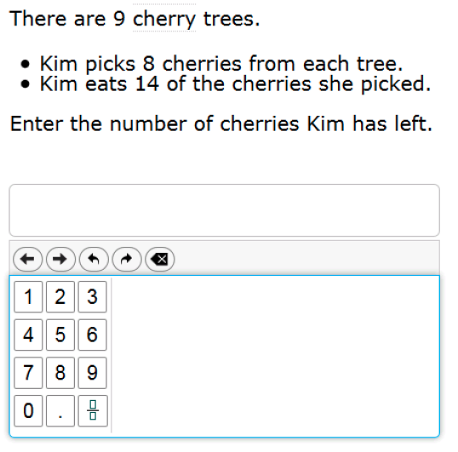
Items are designed to address the aspect(s) of rigor (conceptual understanding, procedural skill, and application) evident in the language of the content standards.
3.OA.D.8 Solve two-step word problems using the four operations. Represent these problems using equations with a letter standing for the unknown quantity. Assess the reasonableness of answers using mental computation and estimation strategies including rounding.
Notes:
© Item retrieved from the Smarter Balanced Grade 3 Practice Test. Available from http://www.smarterbalanced.org/assessments/; accessed April 2016.
Let’s look at this example item written to illustrate Alignment Principle 2.
Answer key: 58
What makes this item a good illustration of Alignment Principle 2?
This item shows a straightforward application problem aligned to a standard with language suggesting that application is the primary component of rigor intended by the standard. The item also is directly aligned to 3.OA.D.8 by requiring two steps to solve the problem. This particular standard has other important components, such as representing problems and assessing reasonableness of answers, which should also be attended to with items specifically targeting those components to support the full breadth of application articulated in the grade 3 standard.

Slide 12
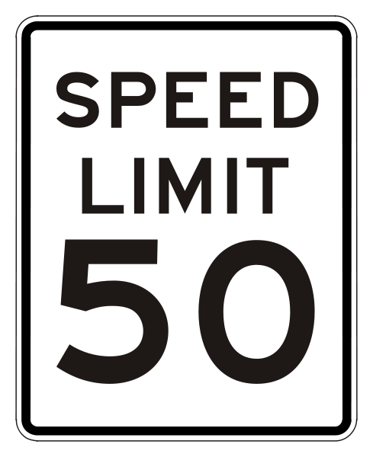

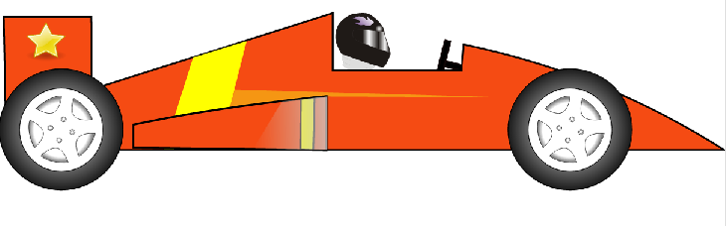
Alignment Principle #3
Items are designed to attend to content limits articulated in the standards.
Notes:
Content limits are often established at the grade level, so it is essential that item writers know and understand the content standards for the entire grade level, not just a single standard for which they may be authoring items. Operations & Algebraic Thinking, Number & Operations in Base Ten, and Number & Operations – Fractions domains all have specific content limits that must be attended to even in items where the direct target of measurement is in a different domain. For example, if students are solving two-step word problems using the four operations in grade 3, and one of the steps happens to be addition, it is important to pay attention to the ceiling established in NBT for addition even though the item will be aligned to the standard in OA.

Slide 13
Items are designed to attend to content limits articulated in the standards.
3.OA.A.4 Determine the unknown whole number in a multiplication or division equation relating three whole numbers.
Notes:
Let’s look at this example item written to illustrate Alignment Principle 3.
Answer key: 11; 8
What makes this item a good illustration of Alignment Principle 3?
This item illustrates the alignment principle showing a problem that is beyond the grade 3 content limit and one that is within the limit. Although not explicitly stated in standard 3.OA.A.4, the content limit for the operations multiplication and division in grade 3 is “within 100,” and items should use single digit factors and quotients to ensure that the focus for grade 3 remains on students’ fluency with the operations multiplication and division within 100.

Slide 14

Alignment Principle #4
Most items aligned to a single content standard should assess the central concern of the standard.
Notes:
Covering the “breadth” of a standard has often meant attending to every noun, verb, and strategy articulated in the standard and breaking it down into very fine-grained, measurable outcomes. So it is common for item authors to look at the “e.g.” portion of the standard and write items that measure each example given. Often these examples illustrate strategies that are useful as part of teaching and learning to help students become mathematically proficient. Items should be designed in such a way that make certain strategies more efficient and/or appealing when such strategies are articulated. However, summative assessments are designed to measure what students have learned and less how they learned it; therefore, we want the items to measure the core desired outcome of the standard, not merely emphasize the choice of strategy.

Slide 15
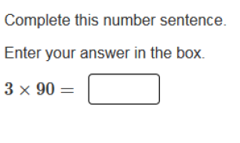
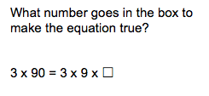
Most items aligned to a single content standard should assess the central concern of the standard.
Central Concern
Not the Central Concern
3.NBT.A.3 Multiply one-digit whole numbers by multiples of 10 in the range 10–90 (e.g., 9 × 80, 5 × 60) using strategies based on place value and properties of operations.
Notes:
© Item retrieved from the PARCC Grade 3 EOY Test. Available from https://prc.parcconline.org/assessments/parcc-released-items; accessed April 2016.
Let’s look at this example item written to illustrate Alignment Principle 4.
Answer key: 270
What makes this item a good illustration of Alignment Principle 4?
This item illustrates the alignment principle by addressing the central concern of this standard, which is that students are able to multiply a one-digit number by a multiple of 10. As part of instruction for developing computational fluency, work should be included that encourages students to use the strategies articulated in the standard, such as recognizing 90 as 9 x 10 and computing 3 x 9 x 10. Where more difficult items are needed, test developers might even choose to include problems like 3 x ? = 270, but as stated in the alignment principle, most items on summative assessments should address the central concern of the standard.

Slide 16

Alignment Principle #5
Representations are well suited to the mathematics that students are learning and serve an important purpose within the item itself.
Notes:
Representations, such as number lines and area models, should be well connected to the mathematics that students are learning and serve an important purpose within the item itself.
When developing an item an item writer should ask: “Is there something mathematically important about including this representation?” If the answer is “Yes,” then the item writer should proceed. The next question the item writer must ask when developing an item should be: “Is the representation giving the appearance of a particular solution path even though other strategies are viable and likely?” The answer to this question should be “No.” Answering these questions will help an item writer decide whether to include a particular representation.

Slide 17
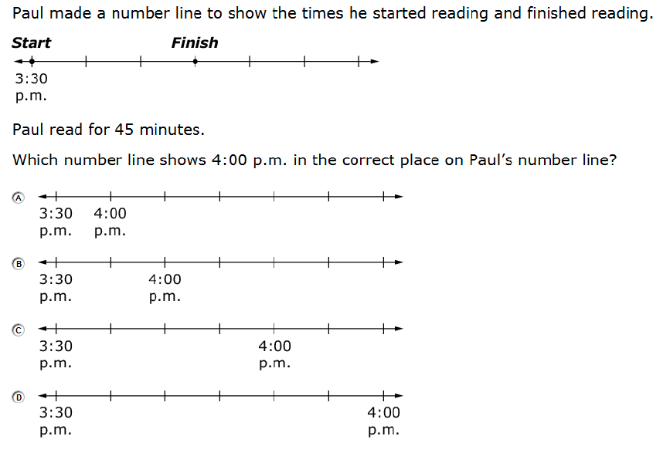
Representations are well suited to the mathematics that students are learning and serve an important purpose within the item itself.
3.MD.A.1 Tell and write time to the nearest minute and measure time intervals in minutes. Solve word problems involving addition and subtraction of time intervals in minutes, e.g., by representing the problem on a number line diagram.
Notes:
© Item retrieved from the Smarter Balanced Grade 3 Practice Test. Available from http://www.smarterbalanced.org/assessments/; accessed April 2016.
Let’s look at this example item written to illustrate Alignment Principle 5.
Answer key: B
What makes this item a good illustration of Alignment Principle 5?
In this case, the representation is well connected to the mathematics of the problem and serves an appropriate role in supporting students’ understanding of what the problem is asking them to do. The number line diagram that is prominently featured as a representation in the Number & Operations – Fractions domain in grades 3 through 5 is effectively used here in the Measurement & Data domain with a problem that blends application and conceptual understanding. The representation reflects a good use of the “e.g.” portion of standard 3.MD.A.1.

Slide 18

Alignment Principle #6
Items use mathematically precise language, are free from mathematical errors or ambiguities, and are aligned to the mathematically appropriate standard.
Notes:
This alignment principle covers a range of issues related to the mathematical and technical quality of items, from using “least” instead of “fewest,” to failing to adequately specify what is meant by “one cubic unit” in a visual image. This is one of the more challenging aspects to train writers and reviewers on due to the type of specific content knowledge needed to successfully identify issues. Incorporating mathematicians into review processes for at least a subset of the total development can provide some assurance that this principle is being well attended to by item authors and/or reviewers.

Slide 19
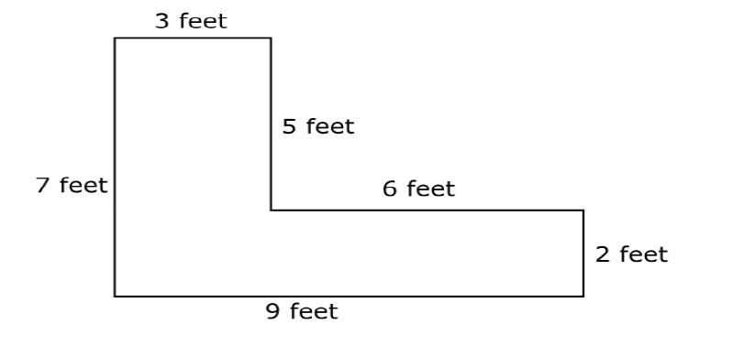
Items use mathematically precise language, are free from mathematical errors or ambiguities, and are aligned to the mathematically appropriate standard.
Two rectangles are joined to create the figure shown.
Enter the area, in feet, of the figure.
3.MD.C.7.d Recognize area as additive. Find areas of rectilinear figures by decomposing them into non-overlapping rectangles and adding the areas of the non-overlapping parts, applying this technique to solve real world problems.
Notes:
© Item adapted from the Smarter Balanced Grade 3 Practice Test. Available from http://www.smarterbalanced.org/assessments/; accessed April 2016.
Let’s look at this example item written to illustrate Alignment Principle 6.
Answer key: [cannot answer accurately]
What makes this item a good illustration of Alignment Principle 6?
This item illustrates the alignment principle, showing a relatively common error where an incorrect unit is used in the item stem. Another common issue is the omission of units. Units can either be stated in the item stem or following the student response box depending on the particular item authoring and test delivery systems being used, but they must be stated and must be correct for the item to be considered mathematically precise.

Slide 20

Alignment Principle #7
The demands of items measuring the Standards for Mathematical Practice are appropriate to the targeted grade level.
Notes:
The Standards for Mathematical Practice should reflect a growing arc of sophistication in assessment items. In early grades, students might give examples or non-examples to show their understanding of a particular claim, but are not asked to prove it or show that it is true for all cases. Similarly, younger students begin modeling real-world situations with equations, but do not engage in the full modeling cycle shown in the high school standards.

Slide 21
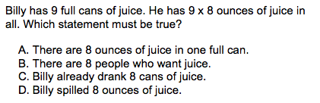
The demands of items measuring the Standards for Mathematical Practice are appropriate to the targeted grade level.
MP2. Reason abstractly and quantitatively.
3.OA.A.1 Interpret products of whole numbers, e.g., interpret 5 × 7 as the total number of objects in 5 groups of 7 objects each.
Notes:
© Item adapted from the Smarter Balanced Grades 3-5 Claim 2 Item Specifications. Available from http://www.smarterbalanced.org/assessments/; accessed April 2016.
Let’s look at this example item written to illustrate Alignment Principle 7.
Answer key: A
What makes this item a good illustration of Alignment Principle 7?
Standard 3.OA.A.1 is strongly tied to the expectations of Mathematical Practice 2, reason abstractly and quantitatively. In particular, MP2 requires that in solving problems, students are “attending to the meaning of quantities, not just how to compute them.“ Younger students should have opportunities to think carefully about the meaning of quantities and in some cases, like in the problem shown, they should be assessed on this as a separate skill rather than as part of a more sophisticated problem-solving process.

Slide 22
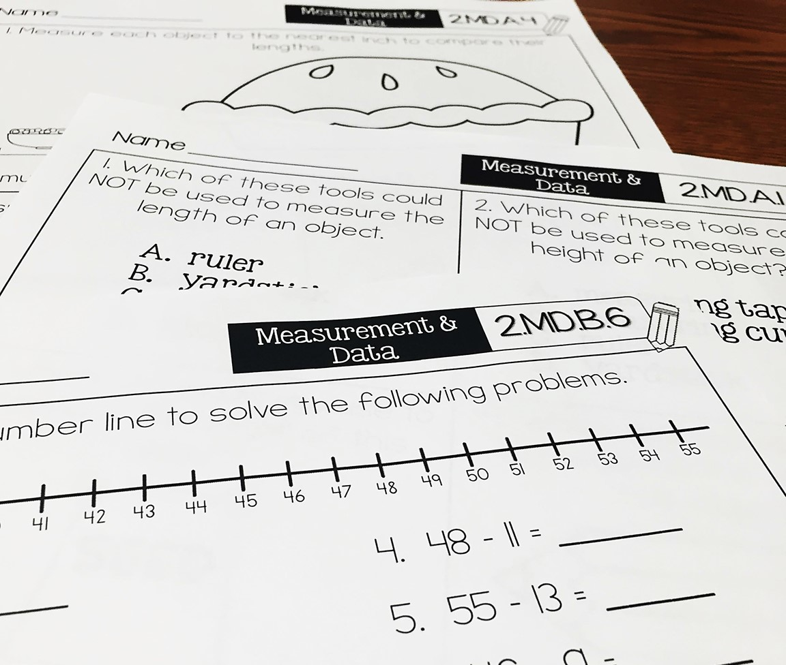
Alignment Principle #8
Item types are chosen to match the item’s purpose and as part of the evidence required by the standards.
Notes:
With many assessments moving online, choices of item type have a lot of driving factors: accessibility, cost, and content. In this section, we will show examples of items that are designed well to meet the evidence required by the standards and are well suited to a particular item’s purpose. This is not to say that a balanced assessment that meets the demands of the standards must include all of these item types nor that this is an exhaustive list of available item types, but that an aligned assessment will include multiple item types. These are illustrations of good ways to collect the evidence required by the standards, but decisions ultimately must be made after carefully considering how to effectively balance cost, content, and accessibility.

Slide 23
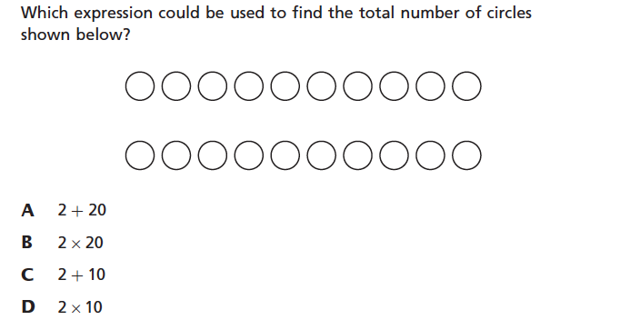
Item types are chosen to match the item’s purpose and as part of the evidence required by the standards.
3.OA.A.1 Interpret products of whole numbers, e.g., interpret 5 × 7 as the total number of objects in 5 groups of 7 objects each.
Notes:
© Item retrieved from EngageNY.org of the New York State Education Department. 2015 Grade 3 Mathematics Test Released Questions. Internet. Available from https://www.engageny.org/resource/released-2015-3-8-ela-and-mathematics-state-test-questions; accessed April 15, 2016.
Let’s look at this example item written to illustrate Alignment Principle 8.
Answer key: D
What makes this item a good illustration of Alignment Principle 8?
There is still room in assessments for carefully crafted multiple-choice items. The reality is that there are many expressions that could be used to find the total number of circles pictured. By making this question multiple choice instead of some open-ended format, such as equation/numeric entry, the answers can be constrained to support alignment to the standard, which is specifically asking students to interpret products of whole numbers, reinforcing the equal groups understanding of multiplication articulated in the grade 3 standards.

Slide 24
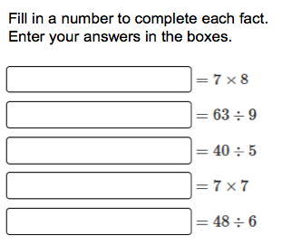
Item types are chosen to match the item’s purpose and as part of the evidence required by the standards.
3.OA.C.7 Fluently multiply and divide within 100, using strategies such as the relationship between multiplication and division (e.g., knowing that 8 × 5 = 40, one knows 40 ÷ 5 = 8) or properties of operations. By the end of Grade 3, know from memory all products of two one-digit numbers.
Notes:
© Item retrieved from the PARCC Grade 3 EOY Test. Available from https://prc.parcconline.org/assessments/parcc-released-items; accessed April 2016.
Let’s look at this example item written to illustrate Alignment Principle 8.
Answer key: 56; 7; 8; 49; 8
What makes this item a good illustration of Alignment Principle 8?
Items measuring procedural skill and fluency should largely be administered using either an equation/numeric entry or some other technology that recognizes the number entered as the correct one. Multiple choice falls short here because of the expectation for accuracy. Narrowing the list of potential answers to only four or five possible choices would greatly impact the ability to cleanly measure the accuracy component of procedural skill and fluency.

Slide 25
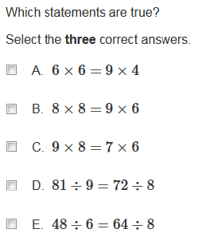
Item types are chosen to match the item’s purpose and as part of the evidence required by the standards.
3.OA.C. Multiply and divide within 100.
Notes:
© Item retrieved from the PARCC Grade 3 EOY Test. Available from https://prc.parcconline.org/assessments/parcc-released-items; accessed April 2016.
Let’s look at this example item written to illustrate Alignment Principle 8.
Answer key: A, D, E
What makes this item a good illustration of Alignment Principle 8?
Where fluency is the target, some testing programs may require more difficult items in their item pools to help better understand the performance of high-achieving students. In grade 1, students are asked to “understand the meaning of the equal sign, and determine if equations involving addition and subtraction are true or false.” Using this general understanding first articulated in grade 1, higher-difficulty items can be created for grade 3 students using the grade-level expectations articulated in 3.OA.C for multiplication and division within 100. This item is aligned to the cluster here rather than the standard since some choices, such as option C, can be eliminated through a conceptual vs. procedural understanding of multiplication required by 3.OA.C.7. For younger students, it is best to indicate the number of answers students should select unless it directly conflicts with the item’s purpose.

Slide 26
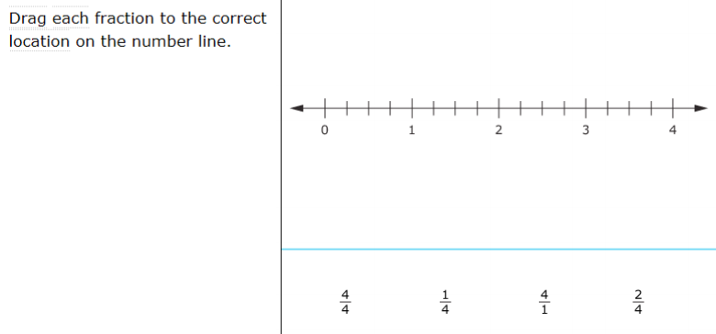
Item types are chosen to match the item’s purpose and as part of the evidence required by the standards.
3.NF.A.2 Understand a fraction as a number on the number line; represent fractions on a number line diagram.
Notes:
© Item retrieved from the Smarter Balanced Grade 3 Practice Test. Available from http://www.smarterbalanced.org/assessments/; accessed April 2016.
Let’s look at this example item written to illustrate Alignment Principle 8.
Answer key: Student drags each number to the correct location on the number line.
What makes this item a good illustration of Alignment Principle 8?
When position is important, drag-and-drop is an effective item type. It is useful for any items that ask students to correctly place numbers or expressions on a number line.

Slide 27
Alignment Principle #9
Most items measuring the Standards for Mathematical Practice are also aligned to content standards representing the major work of the grade.
Notes:
Keeping the assessment focused on the major work of the grade is an important design principle in the overall test construction. In measuring the Standards for Mathematical Practice, it is important to help retain the focus of the test by using many items that align to the major work of the grade.

Slide 28
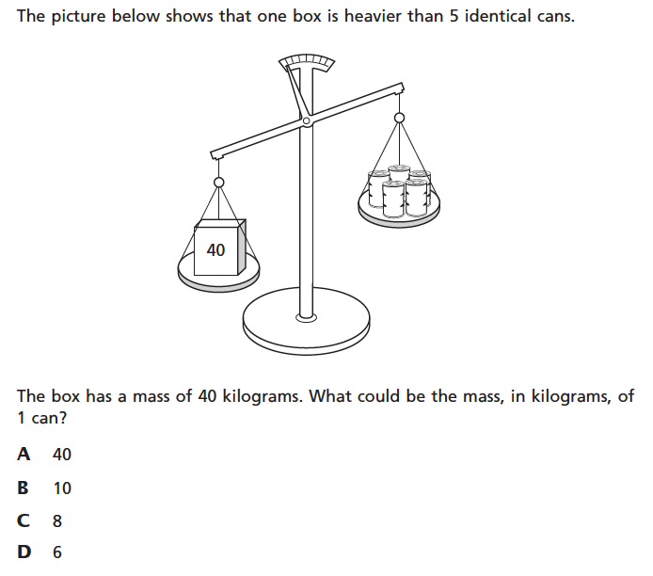
Most items measuring the Standards for Mathematical Practice are also aligned to content standards representing the major work of the grade.
MP.2 Reason abstractly and quantitatively.
3.MD.A.2 Measure and estimate liquid volumes and masses of objects using standard units of grams (g), kilograms (kg), and liters (l).⁶ Add, subtract, multiply, or divide to solve one-step word problems involving masses or volumes that are given in the same units, e.g., by using drawings (such as a beaker with a measurement scale) to represent the problem.
Notes:
© Item retrieved from EngageNY.org of the New York State Education Department. 2015 Grade 3 Mathematics Test Released Questions. Internet. Available from https://www.engageny.org/resource/released-2015-3-8-ela-and-mathematics-state-test-questions; accessed April 15, 2016.
Let’s look at this example item written to illustrate Alignment Principle 9.
Answer key: D
What makes this item a good illustration of Alignment Principle 9?
This item does a nice job of illustrating part of the Standard for Mathematical Practice 2 that states that students should attend “…to the meaning of quantities, not just how to compute them.” Some students may take advantage of the item type here and simply select the smallest value from the list – this alone reflects an important understanding of measurement. Other students may take a more traditional computational approach and compare the computed weight of 5 cans to the other mass shown. In either case, students must recognize that the total mass of the 5 cans must be less than the 40 kilogram weight.

Slide 29

Alignment Principle #10
Items written at the cluster or domain level measure key integration points not necessarily articulated in individual standards but plausibly implied directly by what is written.
Notes:
A few items per test event may serve as opportunities to connect content across standards, domains, or grade levels. These opportunities should be carefully defined with an established purpose tied back to the language and structure of the standards. An item writer might ask: What key connections are students being asked to make to respond to this question that isn’t articulated in any individual standard?

Slide 30
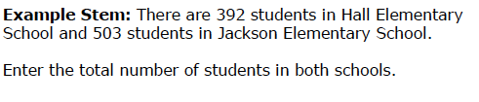
Items written at the cluster or domain level measure key integration points not necessarily articulated in individual standards but plausibly implied directly by what is written.
3.OA.D. Solve problems involving the four operations, and identify and explain patterns in arithmetic.
Notes:
© Item retrieved from the Smarter Balanced Grade 3 Claim 1 Item Specifications. Available from http://www.smarterbalanced.org/assessments/; accessed April 2016
Let’s look at this example item written to illustrate Alignment Principle 10.
Answer key: 895
What makes this item a good illustration of Alignment Principle 10?
While the NBT domain doesn’t explicitly require word problems, the OA domain requires problems that use the four operations. This provides a nice opportunity to write problems that take into account the work that students are doing with addition and subtraction in the NBT domain, where it is expected in grade 3 that students become fluent with 3-digit sums and differences. This item aligns at the cluster level since it is a one-step problem vs. the two-step problems required by 3.OA.D.8.

Slide 31
Ten Principles of CCSS-Aligned Items
1. Most items aligned to standards in supporting clusters connect to the major work of the grade.
2. Items are designed to address the aspect(s) of rigor (conceptual understanding, procedural skill, and application) evident in the language of the content standards.
3. Items are designed to attend to content limits articulated in the standards.
4. Most items aligned to a single content standard should assess the central concern of the standard.
5. Representations are well suited to the mathematics that students are learning and serve an important purpose within the item itself.
6. Items use mathematically precise language, are free from mathematical errors or ambiguities, and are aligned to the mathematically appropriate standard.
7. The demands of items measuring the Standards for Mathematical Practice are appropriate to the targeted grade level.
8. Item types are chosen to match the item’s purpose and as part of the evidence required by the standards.
9. Most items measuring the Standards for Mathematical Practice are also aligned to content standards representing the major work of the grade.
10. Items written at the cluster or domain level measure key integration points not necessarily articulated in individual standards but plausibly implied directly by what is written.
Notes:
The principles illustrated throughout this module are intended to support those charged with developing summative mathematics assessment items and to support training efforts for those who review the content of items.

Slide 32
Thank You!

